Slide 1
Coupon Acceptance Rate Exploration
Bryan Walsh

Slide 2
Introduction
Goal:
Explore factors affecting coupon acceptance rate
Data:
Collected from survey on Amazon Mechanical Turk and found on UCI Machine Learning repository.
Coupon Types include “Bar”, “Coffee House”, “Restaurant <$20”, “Restaurant $(20-50)” and “Carry Out”.
Contains coupon types and acceptance filed Y/N and personal information about customers including income, occupation, gender, age, has children…
Analysis:
Performed using Pandas in the Jupyter notebook environment using Seaborn graph tools.

Slide 3
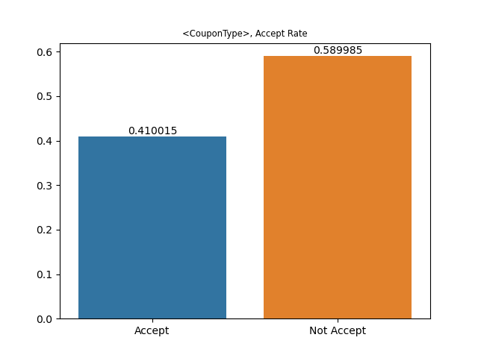
Exploration
I choose to explore how income and having children affects the acceptance rate of coupons of various types.
To the right is the anatomy of the chart used in this report.
The two bars represent the acceptance rate.
The title contains the coupon type and the feature being explored.

Slide 4
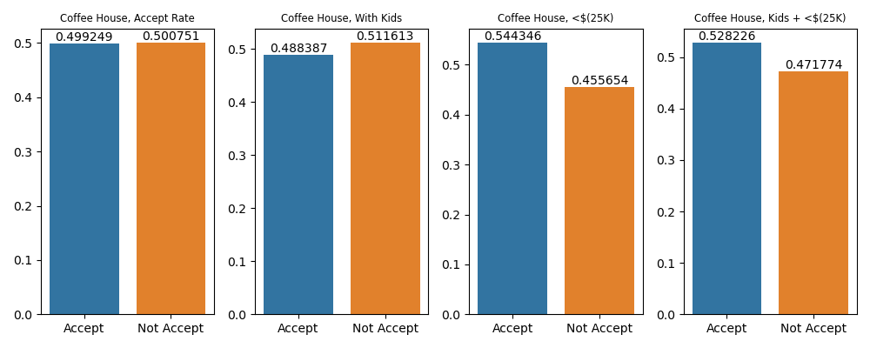
Coffee House Accept Rate
There was a noticeable positive change in acceptance rates for Coffee House coupon from the lower income category and a negative acceptance rate for those with children.
The left most graph is the overall acceptance rate for the Coffee House coupon.

Slide 5
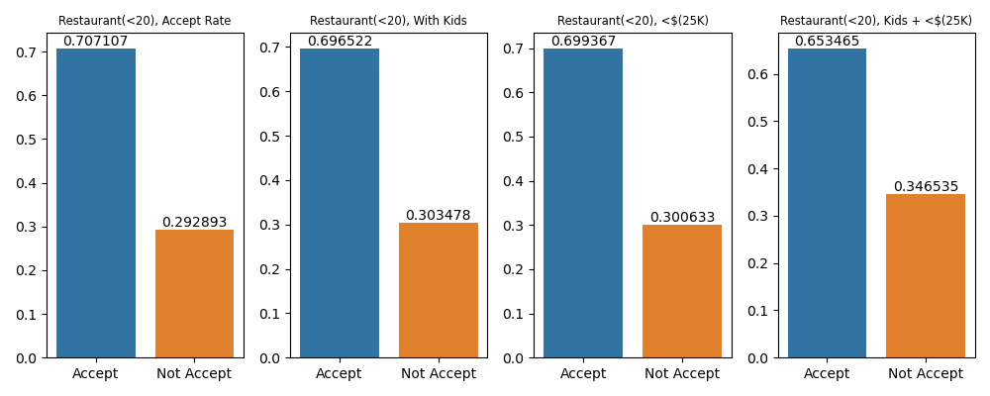
Less Expensive Restaurants
There is a noticeable drop in acceptance rates when exploring the combination of households with children and lower income levels (shown by far right graph).

Slide 6
Conclusion
The income level affects the acceptance rates for Coffee House coupons.
The combination of households with children and lower income lowers the acceptance rates of less expensive Restaurants.

